Slide 1

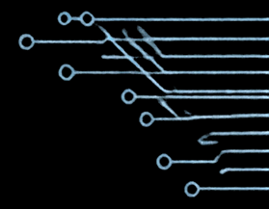

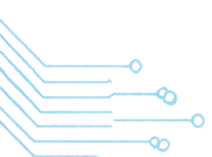
ENCODER AND DECODER IN DIGITAL ELECTRONICS
B.Tech CSE | Digital Electronics (UEC3001)
Shri Ramswaroop Memorial University
ENCODER AND DECODER
Fundamentals, Working Principles and Applications
Saurabh Pandey
202510101150168
Branch: B.Tech CSE (DS+ AI)
Subject: Digital Electronics (UEC3001)
Submitted to :
Mr. Prabhat Srivastava

Slide 2

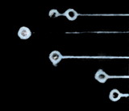
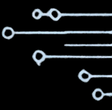













ENCODER AND DECODER IN DIGITAL ELECTRONICS
B.Tech CSE | Digital Electronics (UEC3001)
Shri Ramswaroop Memorial University
Introduction
ENCODER
2ⁿ inputs
n outputs
l₀
Y
An encoder converts one active input line into a coded binary output.
n-1
l₁
ENCODER
Y
n-2
A decoder converts a binary input code into one selected output line.
l₂ⁿ-1
Y₀
Both encoders and decoders are combinalational logic circuits used to represent, select, and route digital information efficiently.
DECODER
n inputs
2ⁿ outputs
X
Y₀
n-1
X
Y
n-2
DECODER
The basic encoder assumes only one input is active at a time.
X₀
Y
2ⁿ-1

Slide 3

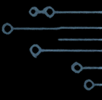








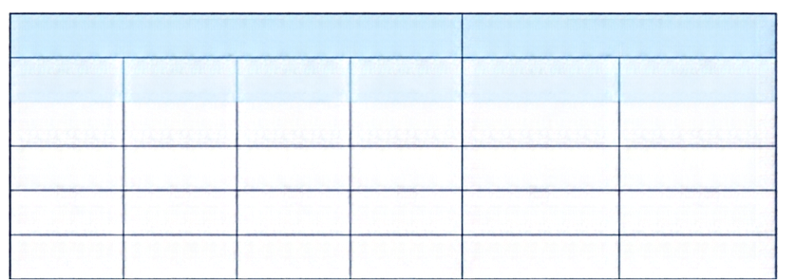
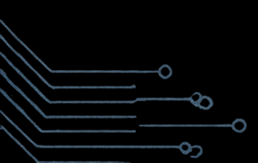
ENCODER AND DECODER IN DIGITAL ELECTRONICS
B.Tech CSE | Digital Electronics (UEC3001) Shri Ramswaroop Memorial University
Encoder
4-to-2 Encoder (Block Diagram)
Do
An encoder converts one of several active input lines into a binary code on fewer output lines.
Inputs (Active-High)
D1
Y1
Do, D1, D2, D3
4-to-2 ENCODER
A basic active-high 4-to-2 encoder assumes that only one input is active (logic 1) at a time; the corresponding binary code appears at the outputs.
D2
Yo
Outputs
D3
Y1, Yo
Truth Table (Active-High 4-to-2 Encoder)
Boolean Expressions
Inputs
Outputs
Note:
All-zero or multiple active input conditions are outside the basic encoder assumption.
D3
D2
D1
Do
Y1
Yo
Y₁ = D₂ + D₃
0
0
0
1
0
0
Y₀ = D₁ + D₃
0
0
1
0
0
1
0
1
0
0
1
0
1
0
0
0
1
1

Slide 4

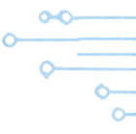




















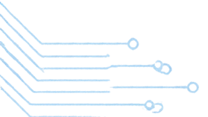
ENCODER AND DECODER IN DIGITAL ELECTRONICS
B.Tech CSE | Digital Electronics (UEC3001)
Shri Ramswaroop Memorial University
Types of Encoder
4-to-2 Encoder
8-to-3 Encoder
Priority Encoder
Maps one of four active input lines to a 2-bit binary code.
Maps one of eight active input lines to a 3-bit binary code.
Resolves multiple active inputs by assigning priority to the highest-priority input and outputs its binary code.
4 inputs
2 outputs
8 inputs
3 outputs
n inputs
m outputs
D₀
D₀
D₁
D₀
Y
Y₂
m-1
D₁
4-to-2
Encoder
Y₁
D₂
D₁
8-to-3
Encoder
PRIORITY
ENCODER
Y
D₃
Y₁
D₂
m-2
D₂
Y₀
D₄
:
:
D₃
D₅
D₆
Y₀
D₇
D
Y
n-1

Slide 5

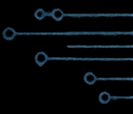








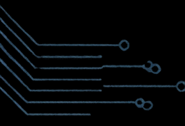

B.Tech CSE | Digital Electronics (UEC3001)
Shri Ramswaroop Memorial University
ENCODER AND DECODER IN DIGITAL ELECTRONICS
Decoder
A decoder converts n binary input lines into up to 2ⁿ output lines.
For each valid input code, one output line is selected and set HIGH.
This slide shows a 2-to-4 decoder with Enable using active-high logic.
2-to-4 Decoder Block Diagram
Truth Table (Active-High, E = 1)
Boolean Expressions
Y₀
Inputs
Outputs
Y₀
E· A₁′ A₀
A₁
A₁
A₀
Y₀
Y₁
Y₂
Y₃
2-to-4
DECODER
Y₁
0
0
1
0
0
0
Y₁
E· A₁′ A₀
A₀
Y₂
0
1
0
1
0
0
Y₂
=
E· A₁ › A₀
(Active-High)
Enable (E)
1
0
0
0
1
0
Y₃
1
1
0
0
0
1
Y₃
=
E· A₁ › A₀
Enable (E) controls whether the decoder is active. When E = 0, all outputs are LOW. Outputs are active-HIGH: the selected output line goes HIGH for the valid input code.

Slide 6
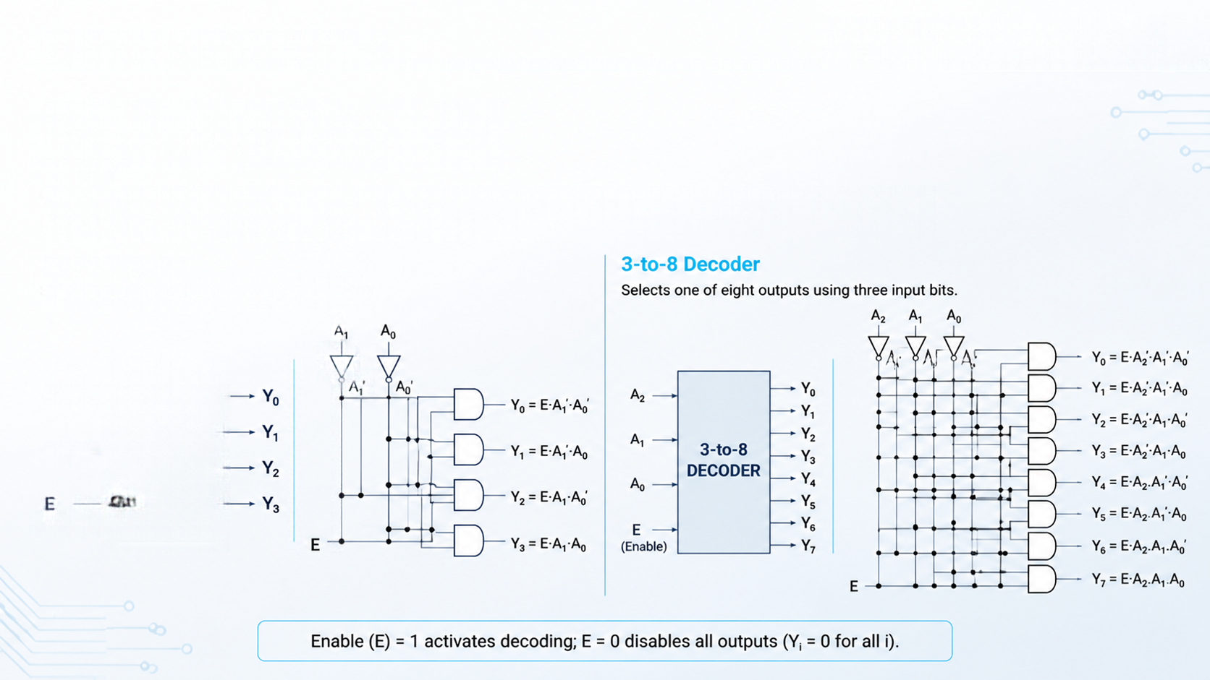




B.Tech CSE | Digital Electronics (UEC3001)
Shri Ramswaroop Memorial University
ENCODER AND DECODER IN DIGITAL ELECTRONICS
Types of Decoder
Decoders select one output line based on the binary input code. These diagrams use active-high outputs.
Enable input controls whether decoding is active.
2-to-4 Decoder
Selects one of four outputs using two input bits.
A
A
A
2-TO-4
DECODER
(Enable)

Slide 7

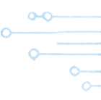











B.Tech CSE | Digital Electronics (UEC3001)
Shri Ramswaroop Memorial University
ENCODER AND DECODER IN DIGITAL ELECTRONICS
Difference and Applications
Aspect
Encoder
Decoder
Conversion
Converts one selected input line into a coded binary output
Converts a binary input code into one selected output line
Input / Output Count
2ⁿ inputs → n outputs
n inputs → 2ⁿ outputs
Active-line Behaviour
One input is assumed active
at a time
One output line is active for each valid input code
Typical Use
Data encoding and
input reduction
Data selection and
output distribution
Applications of Encoders
Applications of Decoders
Keyboards and keypad encoding
Priority interrupt systems
Data compression and coding
Communication interfaces
Display drivers and seven-segment control
Memory or chip selection
Instruction decoding
Demultiplexing and data distribution
Both encoders and decoders are combinational building blocks used to represent, select, and route digital information efficiently in digital systems.

Slide 8

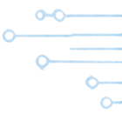

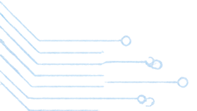
ENCODER AND DECODER IN DIGITAL ELECTRONICS
B.Tech CSE | Digital Electronics (UEC3001)
Shri Ramswaroop Memorial University
Conclusion and References
Encoders convert one selected input into a
binary code.
Decoders convert a binary code into
one selected output.
Thank You
Correct active-high assumptions and Boolean expressions are essential for reliable design.
Encoders and decoders are vital in keyboards, displays, communication interfaces, instruction decoding and digital control systems.

